Slide 1
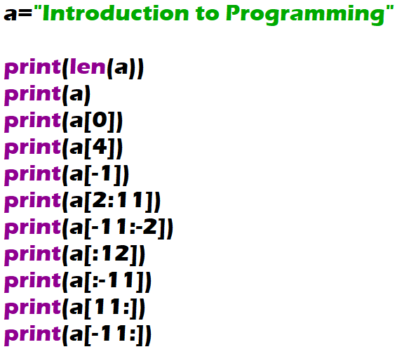
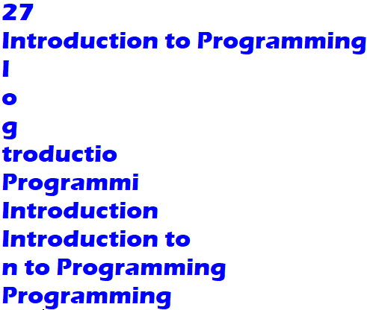

Slide 2


A four-digit integer is given. Output an integer obtained from the given one by reading it from right to left.

